Slide 1

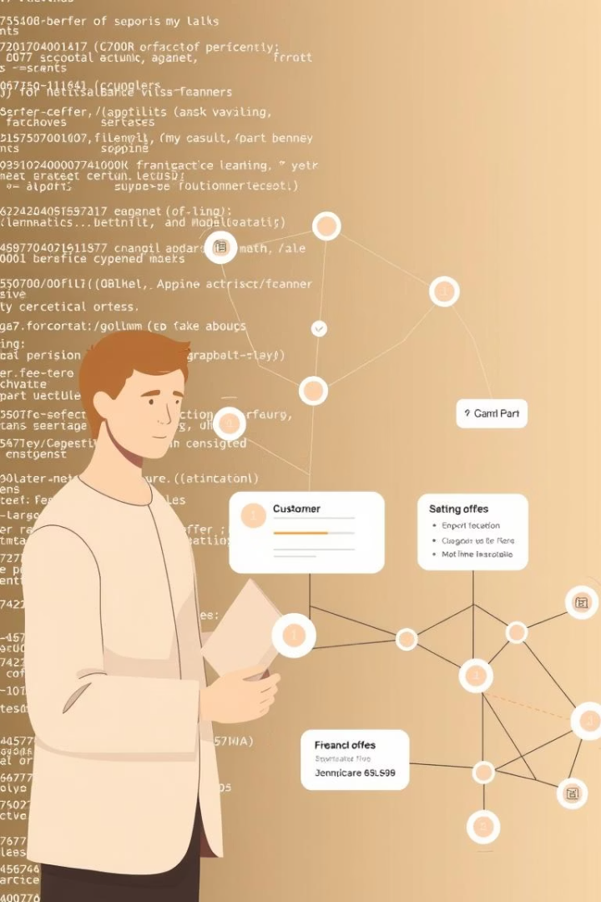
Implementing and Testing a Machine Learning Recommender System
Using Machine Learning to Enhance Customer Engagement in Banking
Presented by: ELETHU MOLOSE SIYABONGA KHULONG MASHILWANE MODUPI HOPE DLAMINI BENNEDICT MKHONTO
FNB DataQuest

Slide 2




Abstract: Personalized Customer Experiences
In today’s competitive digital marketplace, personalized customer experiences are crucial for driving engagement, satisfaction, and loyalty. This project aims to develop a recommender system that prioritizes and ranks personalized offers tailored to individual customer needs, inferred from contextual data like browsing behavior, purchase history, and demographics.
Customer Needs
Business Outcomes
Tailoring offers based on individual customer data.
Increasing conversions and improving customer retention.
Modeling Approaches
Exploring techniques for high-quality, context-aware recommendations.

Slide 3
Introduction: Personalization in Banking
In banking, personalization is key to customer engagement and business growth. FNB leverages machine learning and recommender systems to analyze customer data, predicting and suggesting relevant products. This approach aims to increase conversion rates, boost revenue, and improve customer retention by providing timely and relevant offers.
Key Advantages
System Focus
Smarter offers
Data wrangling
Happier customers
Feature selection
Better business results
Model training
Performance analysis

Slide 4
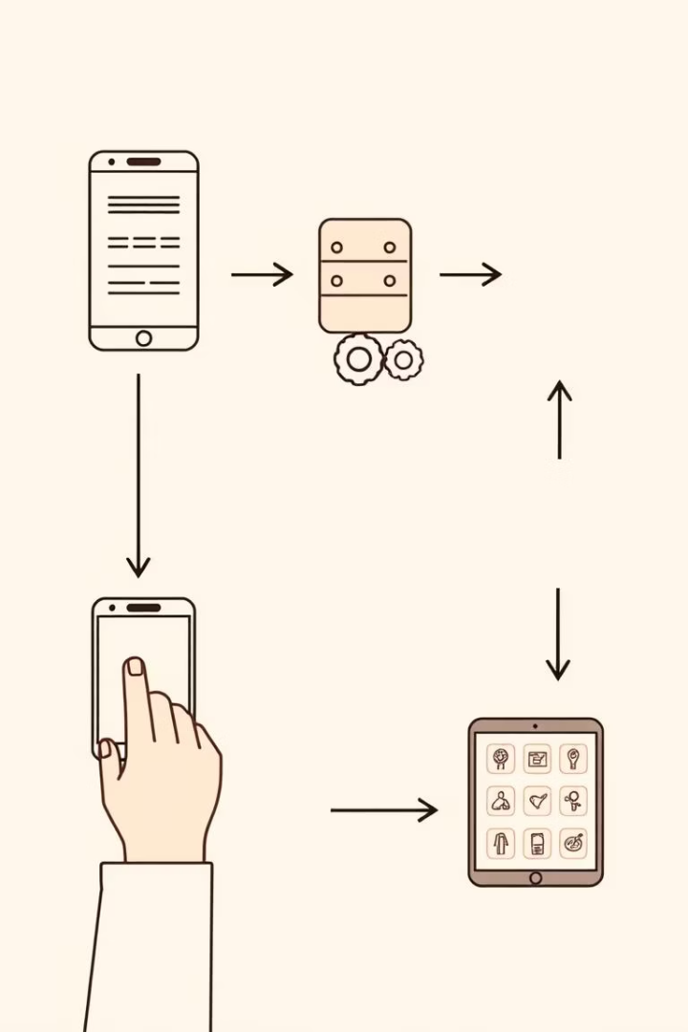




Live Testing the LightFM Model
The objective of live testing is to evaluate the LightFM model's effectiveness in recommending relevant items in a production-like environment. This includes testing with unseen user-item interactions and ensuring dynamic recommendations based on user behavior like clicks or checkouts.
Real-Time Input Simulation
Simulate user actions like clicks, checkouts, or browsing.
Dynamic Interaction Update
Update the interaction matrix with new real-time data.
Generating Recommendations
Use the model to generate top-N item recommendations.
Evaluation
Compare recommendations with actual user actions using metrics like Precision@K and CTR.

Slide 5
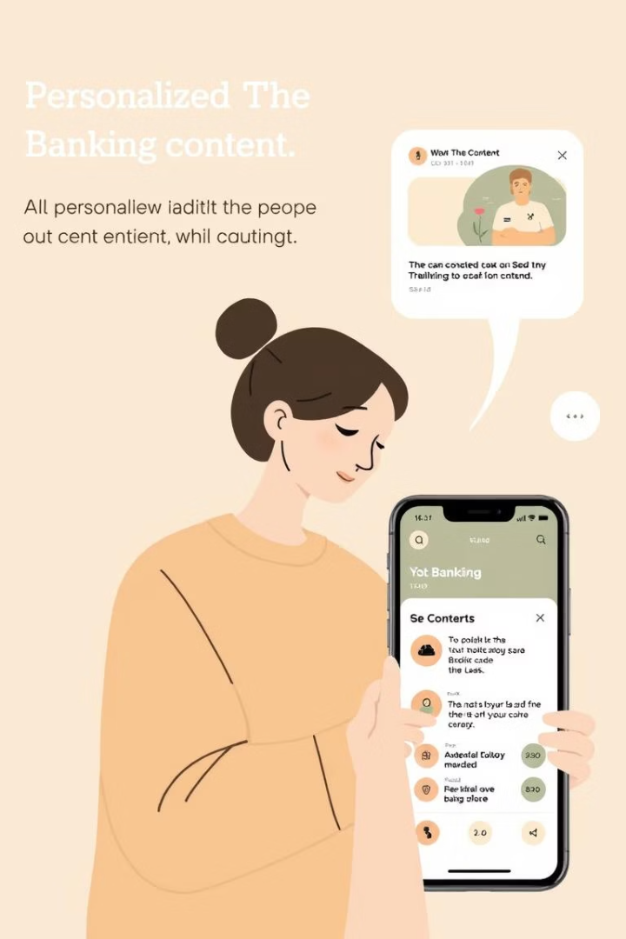
Implementation Plan in Real Life
The recommender system aims to improve the digital product experience by personalizing content for each user, picking up on interaction patterns to recommend relevant products. This enhances user engagement and encourages return visits.
Phased Rollout
Start with active users to test performance, then expand to newer or less active users.
Recommendation Display
Show recommendations in the app/website by changing product display or via smart notifications.
Continuous Improvement
Track progress and refine the system over time for optimal performance.

Slide 6

Conclusion: Enhancing Customer Engagement
This recommender system demonstrates how machine learning can improve customer interaction by suggesting relevant products based on user behavior. This personalization makes the platform more user-friendly and useful, leading to increased satisfaction and loyalty.
User-Centric Design
Business Impact
Scalability
Personalized recommendations reduce irrelevant options, enhancing user experience.
Supports marketing and product strategy, leading to better campaigns and stronger loyalty.
Flexible enough to grow with the platform and make a real difference in a live environment.

